Slide 1
Applying Data Warehouse Techniques
Going from Descriptive to Predictive

Slide 2

About Me
Graduated from TN Tech in December 2011
Living in Mount Juliet, TN
Work in Nashville
Dove right into BI and DW using SQL Server
Asurion
HealthSpring
NaviHealth

Slide 3
Think Data Insights
Based out of Brentwood, TN (Nashville)
Enterprise Data Platform
BI/Analtyic Solutions
Data Integration, Conversion, and Mirgrations
Excel based Analytics and Automation Solutions

Slide 4
Overview
Data Warehousing 101
The Dimensional Model
The Receipt Example
Demo using Microsoft SQL Server
Dashboards with Power BI
Data Mining with Analysis Services

Slide 5
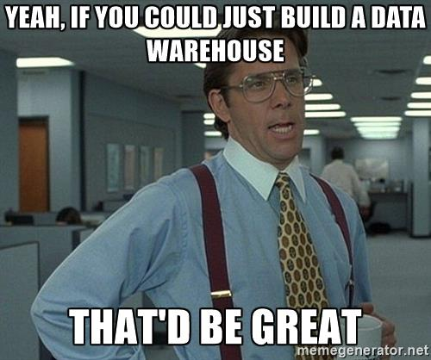
Data Warehousing 101
Data can be stored an used in many forms in a business
Application Databases
Excel workbooks
3rd party applications/data sources
Event stream
Polyglot Persistence
Would like to analyze data across all these sources
Need to off load into separate system in order to not disrupt application systems

Slide 6
OLTP vs OLAP
Application systems are typically optimized for dealing with a few rows of data at a time
On-Line Transactional Processing (OLTP)
Usually working with a single record at a time
Processing a sales transaction, looking up a sales record for a return
This is inefficient for analytical processing
Working with thousands to millions of records at a time
On-Line Analytical Processing (OLAP)
Viewing Total Sales Orders by Sales Territory for FY 2016

Slide 7
OLTP Sales Model

Slide 9
The Dimensional Model
Popularized by Ralph Kimball (The Data Warehouse Toolkit)
ETL Processes data from source systems into a dimensional model
The ETL will be about 70% of a DW Project
Dimensional Models contain two types of tables
Dimension Tables
Nouns of the business – Describe the business process
Examples: Date, Customer, Product, Store, Geography, Employee
Fact Tables
Verbs of the business – Measure the business process
Examples: Sales, Patient Visit, Inventory, Attendance, Claims
Gives us Scalability, Performance, and Simplicity
Notes:
Expand on ETL -> Draw a diagram of different sources that load into the DW

Slide 10
The Dimensional Model
“In general, a star schema following Kimball modeling techniques is the optimal data model to build into a Tabular model. “
Performance Tuning of Tabular Models in SSAS 2012
https://docs.microsoft.com/en-us/previous-versions/sql/sql-server-2012/dn393915(v=msdn.10)

Slide 11
Dimension Tables
Holds descriptive characteristics of a business process
Denormalized tables
Surrogate Key generated for each row and used in fact table
Allows for single column joins using integers
Also allow for Type II dimensions
Conformed Dimensions
Facts across multiple business processes using the same dimension
Enables drill-across analysis

Slide 12
Dimensions
Slowly changing dimensions
Type I – Update the record, historical data no persevered
Type II – Add a new row, historical data persevered
Type III – Add a new column, allows for comparative analysis
Other Types of Dimensions
Mini-Dimension – Subset of data to reduce table size of a large dimension
Junk Dimension – Low cardinality elements combined into a single dimension
Degenerate Dimension – High cardinality elements left on fact table
Role-Playing Dimension – A dimension used many times in single business process
Demo!!!

Slide 13
Fact Tables
Contain the dimension’s surrogate key and measures for the business process
Largest tables in the warehouse
Columns are surrogate keys to dimensions and measurement values
Typically will have millions of rows, in some cases billions
Defined by the Grain
The grain indicates what an individual row represents in a fact table
“One row per line item in a sales transaction”
Demo!

Slide 14
Type of Fact Tables
Multiple ways to measure and store business events
Some of these are used together to create a complete picture
Transactional Fact Table
Records events as they occur
Data is typically not revisited
Periodic Snapshot Fact Table
Events are measured on intervals
Data is not revisited, new snapshots are inserted into the table
Accumulating Snapshot Fact Table
Used for tables with defined beginning, intermediate, and end milestones
Data is revisited and updated with new information

Slide 15
Four Step Design Process
Kimball defines a four step process
Select the Business Process
Declare the Grain
Identify Dimensions
Identify Facts
Receipt example

Slide 16
Bus Matrix
Communication tool with customers
Quickly tells us what dimensions are available for a business process
Rows are the business process
Columns are the dimensions
Where a dimension crosses multiple business processes, those processes can be viewed across facts

Slide 17
FreddicMac Demo
Data from from Freddie Mac
Home Mortgages originating from January 1999 through March 2017
22,942,396 Loans
1,080,321,205 Loan Payments
All loans are Fixed Rate, 15/20/30 Terms
Took my machine 21 hours to load all the data
Case for Big Data, Schema-On-Read
Data feed into cube
Dashboard with PowerBI
Return Interest Rate based on historical data

